Slide 1
Creating User Interfaces

Slide 2
Today’s Overview
1
Model-View-Controller
2
Practical 1 Walk Through

Slide 3

Model View Controller (MVC)

Slide 4
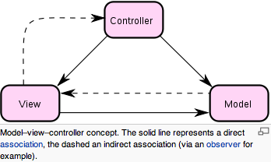
Model-View-Controller (MVC)
MVC is a software design pattern that splits interactions between users and applications into three roles:
Model
View
Controller
Notes:
Business Logic is often broken further into two components in the Model-View-Controller (MVC) paradigm -- the Model, which defines how the data will be stored and retrieved; and the Controller, which controls the interaction between the Model and the View

Slide 5
Model-View-Controller (MVC)
Model
represents your data structures. Typically your model classes will contain functions that help you retrieve, insert, and update information in your database

Slide 6
Model-View-Controller (MVC)
View
is the information that is being presented to a user
For a mobile app, the view would generally be an user interface (UI) page that presents to user

Slide 7
Model-View-Controller (MVC)
View
The view pulls data from the model (which is passed to it from the controller) and feeds the data into a template which is populated and presented to the user
The view does not cause the data to be modified in any way, it only displays data retrieved from the model

Slide 8
Model-View-Controller (MVC)
Controller
The controller is responsible for responding to user actions. In the case of a mobile app, a user action is (generally) a view request.

Slide 9
Model-View-Controller (MVC)
Controller
The controller will determine what request is being made by the user and respond appropriately by triggering the model to manipulate the data appropriately and passing the model into the view

Slide 10
Model-View-Controller (MVC)
Controller
The controller does not display the data in the model, it only triggers methods in the model which modify the data, and then pass the model into the view which displays the data

Slide 11
Restaurant List

Slide 12
Restaurant List
Restaurant List is an Android app to allow user to store restaurant information to local database. It provides features
to allow user to set preference in restaurant list sorting
to set alarm for lunch time
to set alarm alert using activity or system notification through status bar
to access location coordinates and save to record
to show restaurant location on Google Map with a marker

Slide 13
Restaurant List
The 6 practical sessions will provide you a step-by-step guide in building the application
The approach will be following the Model-View-Controller software design pattern

Slide 14
Practical 1 – UI View

Slide 15
User Interface View Design
Applications are usually made up of Views. They provide interaction between user and the app
The basic function of these views is to take inputs from users or present outputs to them

Slide 16
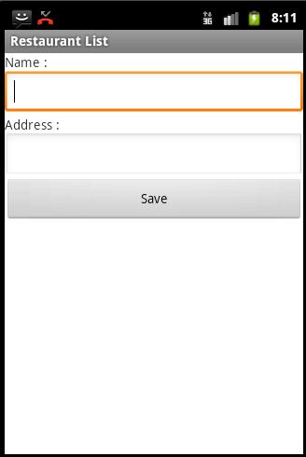
User Interface View Design
For the beginning, a Simple Form will be designed for the UI View using
LinearLayout
TextView
EditText
Button

Slide 17
User Interface View Design
Simple Form
Set the layout to hold the view design
Place in necessary widgets
TextView – to display label to user
EditText – to read data from user
Button – to get user’s request

Slide 18
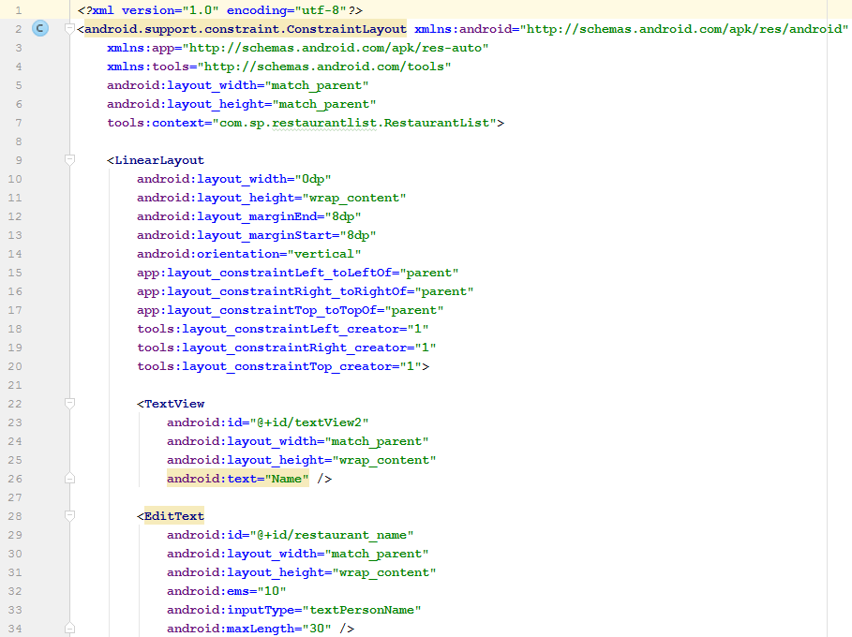
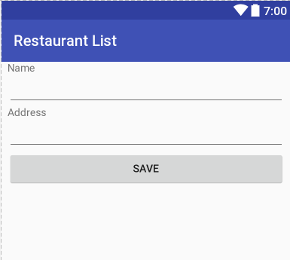
User Interface View Design

Slide 19
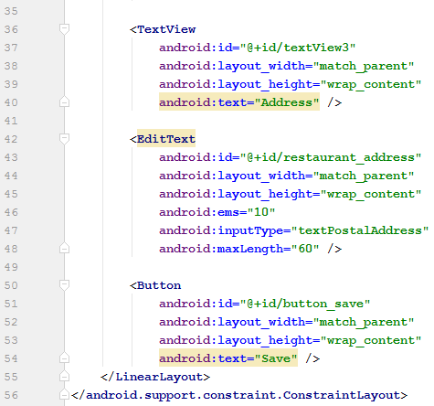
User Interface View Design

Slide 20
User Interface View Design
<TextView android:layout_width="match_parent" android:layout_height="wrap_content" android:text="Address" /> <EditText android:id="@+id/restaurant_address" android:layout_width="match_parent" android:layout_height="wrap_content" android:ems="10" android:inputType="textPersonName" /> <Button android:id="@+id/button_save" android:layout_width="match_parent" android:layout_height="wrap_content" android:text=“Save" /> </LinearLayout> </android.support.constraint.ConstraintLayout>

Slide 21
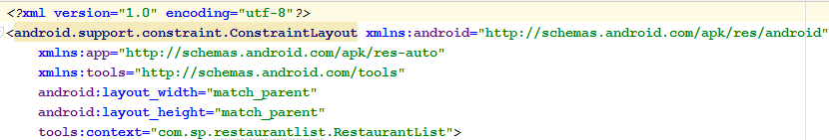
UI View Design
ConstraintLayout
xmlns:android attribute define the XML name space to be refer to
XML Namespaces provide a method to avoid element name conflicts

Slide 22
UI View Design
ConstraintLayout
android:layout_width and android:layout_height set the layout to as big as its parent
match_parent is used from API Level ≥ 8
fill_parent is used from API Level < 8

Slide 23
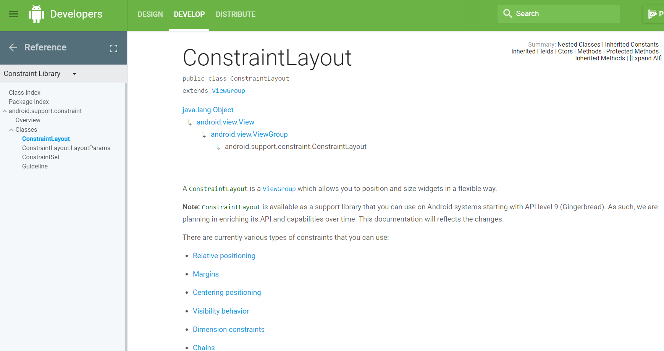
UI View Design
ConstraintLayout
More about ConstraintLayout

Slide 24
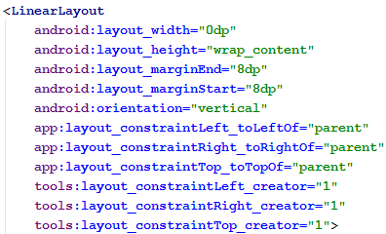
UI View Design
LinearLayout
android:layout_width set the layout to as big as its parent
android:layout_height set the layout to as big as its content
android:orientation=“vertical” sets the LinearLayout to single column

Slide 25
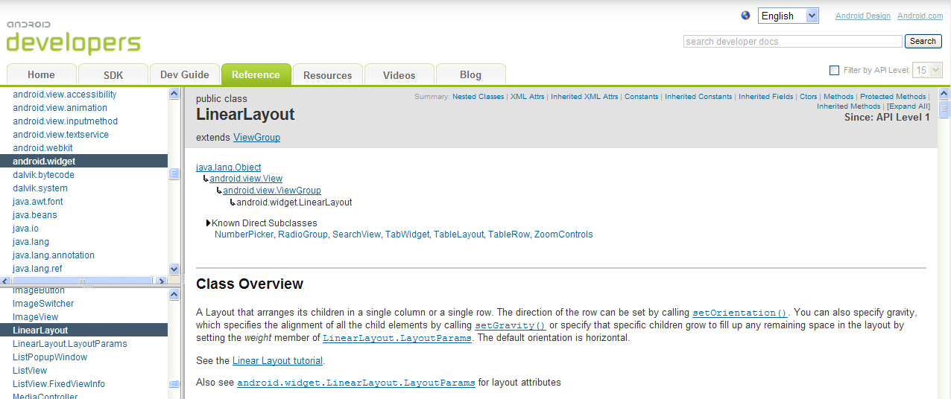
UI View Design
LinearLayout
More about LinearLayout

Slide 26

UI View Design
TextView
To display text to the user and optionally allows them to edit it
Setting a View's size to wrap_content will force it to expand only far enough to contain the values (or child controls) it contains
android:text sets the label displayed

Slide 27
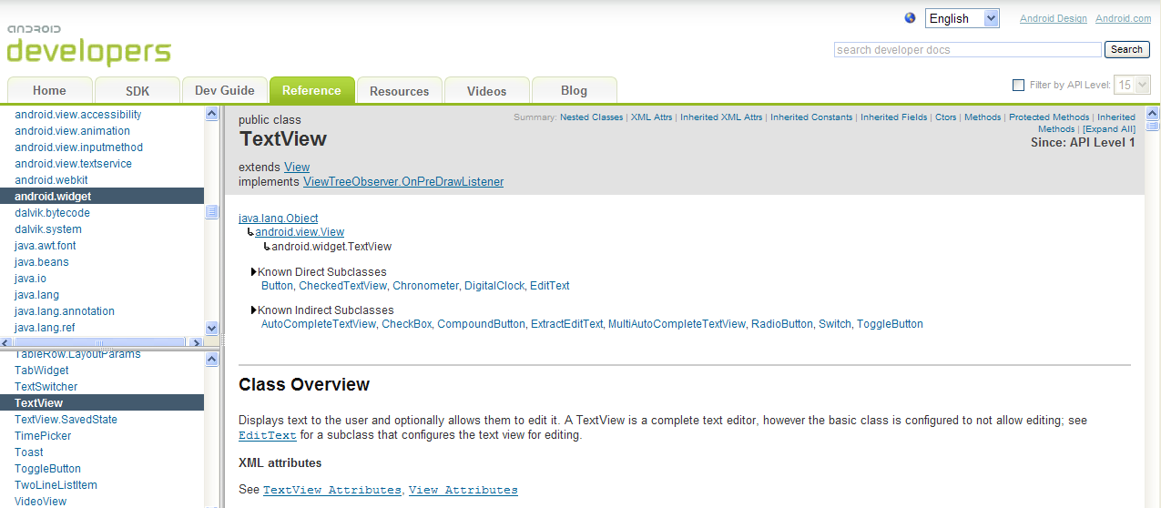
UI View Design
TextView
More about TextView widget

Slide 28
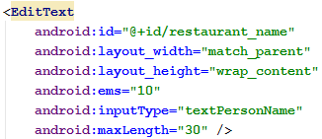
UI View Design
EditText
android:id =“@+id/restaurant_name” creates an id named restaurant_name for the widget in the namespace of the app
This will allow the app to access to it through its id

Slide 29
UI View Design
EditText
android:ems=“10” sets to 10 em units (optional) (Refer to http://www.intertech.com/Blog/post/Android-Widget-Size.aspx for more detail about em)

Slide 30
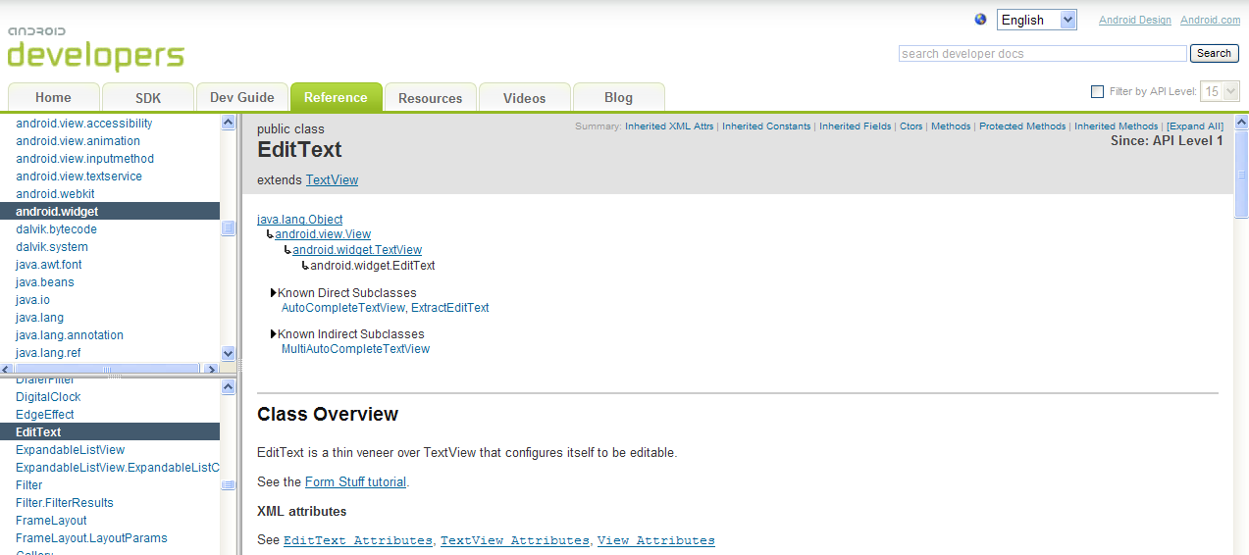
UI View Design
EditText
More about EditText widget

Slide 31
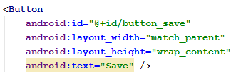
UI View Design
Button
Represents a push-button widget. Push-buttons can be pressed, or clicked, by the user to perform an action
android:id =“@+id/button_save” creates an id named button_save in the namespace of the app

Slide 32
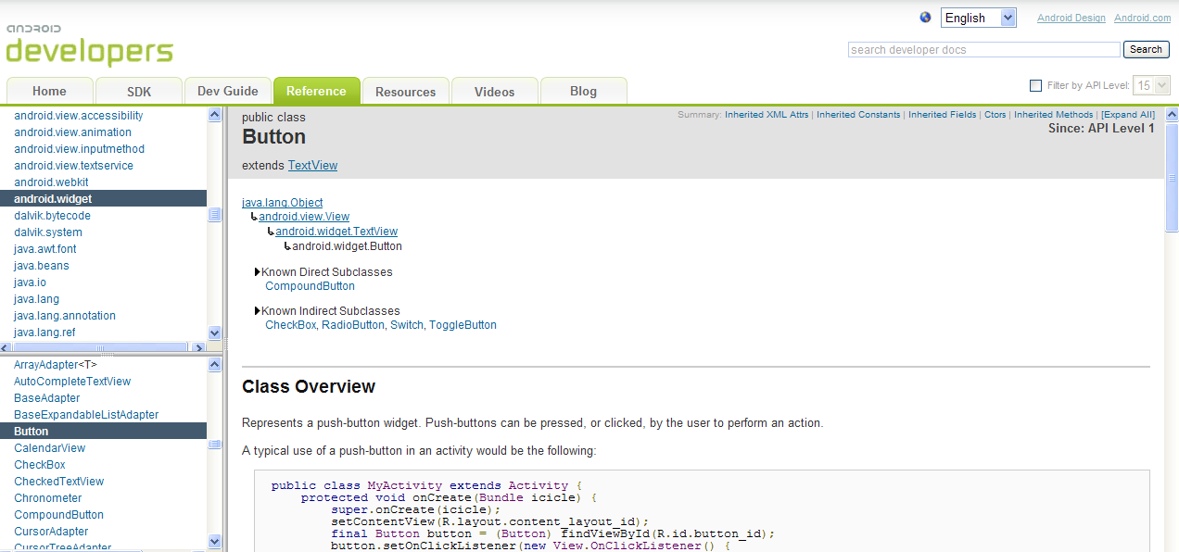
UI View Design
Button
More about Button widget

Slide 33
Practical 1 – Fancier UI View

Slide 34
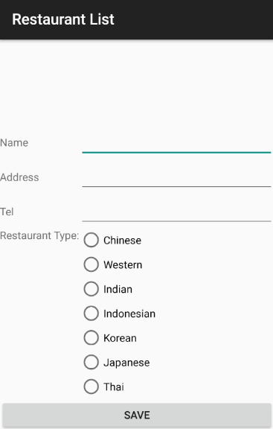
User Interface View Design
Instead of using LinearLayout with single column, TableLayout is used to improve the view design by arranging widgets in columns for optimization

Slide 35
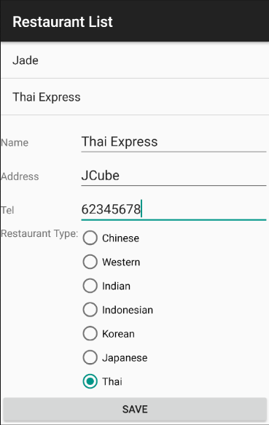
User Interface View Design
The new form includes
TableLayout & TableRow – to arrange widgets in columns
RadioGroup & RadioButton – for restaurant type selection
ListView – to keep the restaurant records

Slide 36
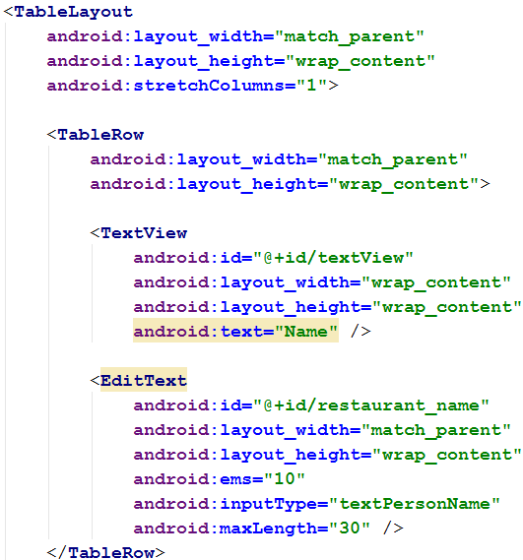
User Interface View Design
TableLayout
A layout that arranges its children into rows and columns and it consists of a number of TableRow objects

Slide 37
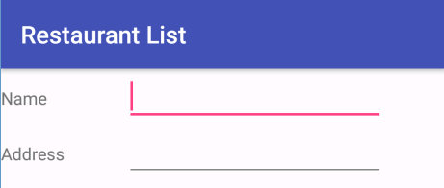

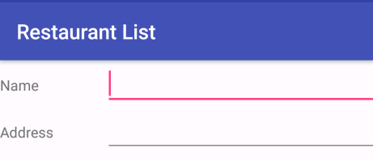
User Interface View Design
TableLayout
android:stretchColumn=“1” stretches the EditText widget which is at column 1 to occupy the screen

Slide 38
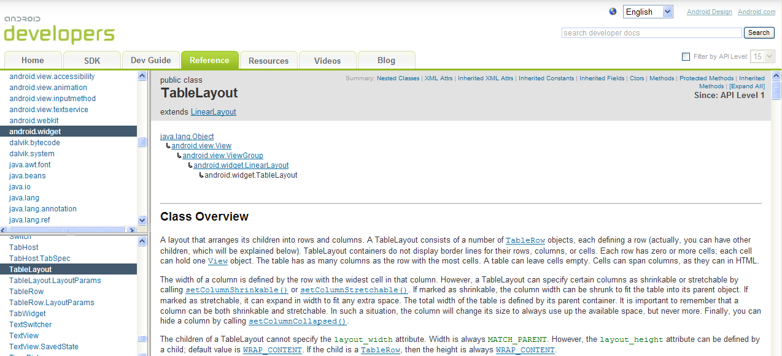
User Interface View Design
TableLayout
More about TableLayout & TableRow

Slide 39
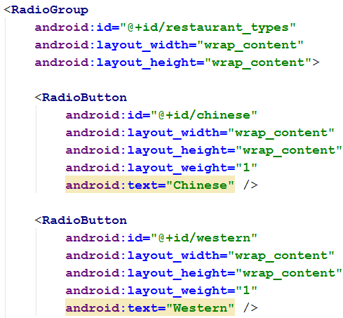
User Interface View Design
RadioGroup
It is used to create a multiple-exclusion scope for a set of radio buttons

Slide 40
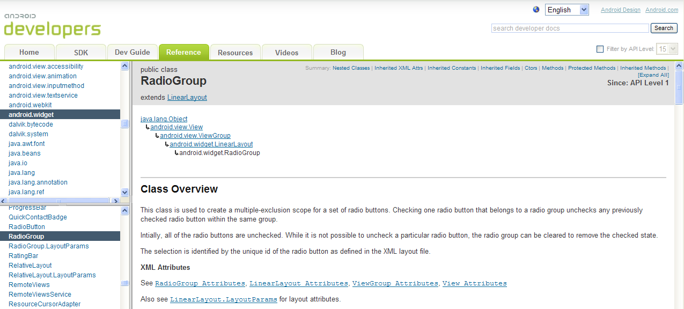
User Interface View Design
RadioGroup
More about RadioGroup widget

Slide 41
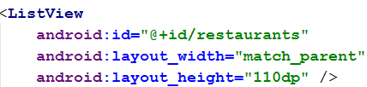
User Interface View Design
ListView
A view that shows items in a vertically scrolling list. The items come from the ListAdapter associated with this view

Slide 42
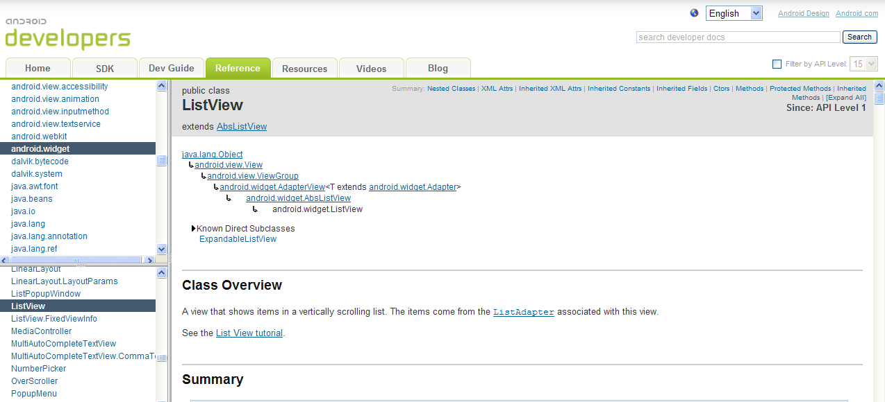
User Interface View Design
ListView
More about ListView

Slide 43
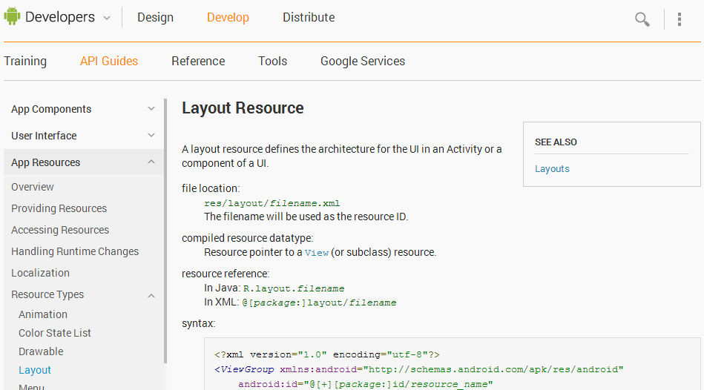
Layout Resource
More on Layout and attributes at
http://developer.android.com/guide/topics/resources/layout-resource.html

Slide 44
Practical 1 – Model

Slide 45
Model
User can see and input data in UI View. As for program, it cannot “see” what human eyes see in View -> it is “blind”!
In order for program to be able to “see” the data on a view, we will need to create a Model with a set of data handling methods (getter and setter) for reading and writing data into memory

Slide 46
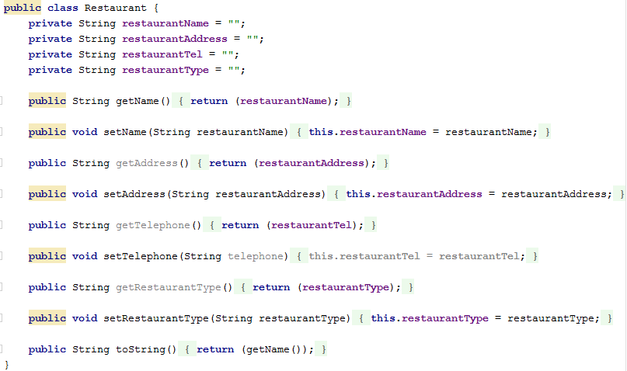
Model
With the view design ready, we want to add a Model class Restaurant.java to hold a single restaurant data
A sets of getters and setters will be created to handle data in the model

Slide 47

Model
restaurant.java Class
Four local data variables are created to store information in the restaurant model and initialised

Slide 48
Model
Methods for writing data into local variables (Setters)

Slide 49
Model
How does a setter work?
Model has created a local variable “restaurantName” (PURPLE colour) in memory
Link the local variable to the View widget through “findViewById”

Slide 50
Model
How does a setter work?
Data “restaurant_name” can be read from the View using getText method from EditText widget
View

Slide 51

Model
How does a setter work?
Pass over the “nameStr” read from View to Model by calling setName (see the RED arrow)

Slide 52
Model
How does a setter work?
Data in “restaurantName” (BLACK colour) will then be saved to Model’s local variable “restaurantName” (PURPLE colour)

Slide 53

Model
Methods for reading data from local variables (Getters)

Slide 54

Model
How does a getter work?
When the getter method getName is called, the data (i.e. the data previously stored by setName method) “restaurantName” (PURPLE colour) in Restaurant model will be returned

Slide 55
Model
The Restaurant model created is only for keeping a single restaurant data. What will happen when we have a list of restaurants?
We will need a bigger model to keep a list of restaurants -> ArrayList

Slide 56
Model
Data of individual restaurant will now be able to be kept in ArrayList model in listing format
Restaurant 1
Restaurant 1
Restaurant 2
Restaurant 2
Array List Restaurant Model
Individual Restaurant Model

Slide 57
Controller

Slide 58
Controller
We have
a UI View for user and
a Model for program
There is a BIG problem -> the two objects do not “see” or “talk” to each other directly!
We need someone in the middle -> The Controller

Slide 59

Controller
The Controller will act as a “middle man” in between UI View (for user) and Model (for program)
It monitors requests from View e.g. Save button is clicked and takes the necessary action with the model provided
Mr “Controller”
Mr “View”
Mr “Model”

Slide 60
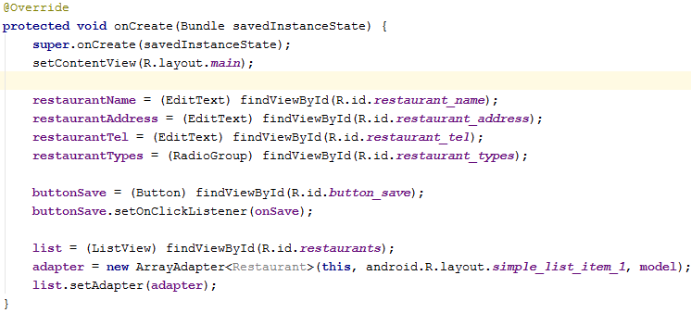
Controller
When RestaurantList Activity first started, the onCreate(Bundle) callback method will be run
Initialisation will be done at here

Slide 61
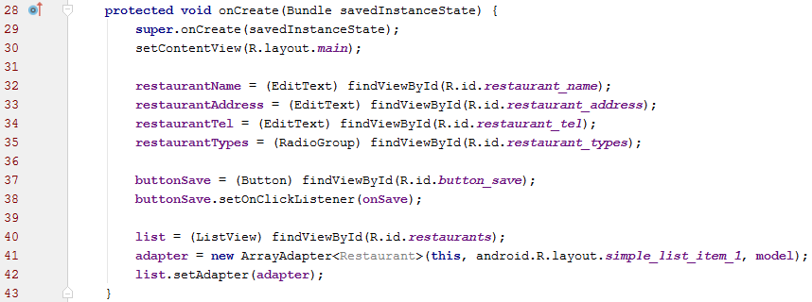
Controller
Line 30 – “setContentView” sets display view layout using main.xml
Line 32 to 40 – “findViewByID” binds local variables to EditText, RadioGroup, Button and ListView widgets on UI View defined in main.xml

Slide 62
Controller
Line 37 - bind the Button varible “buttonSave” to the “Save” button widget on UI View with id “button_save”
Line 38 - activate the click listener to monitor the touch event of the button

Slide 63
ArrayAdapter

Slide 64
ArrayAdapter
Remember Model and View do not “see” each other
To link ArrayList model with ListView widget on UI View, the Controller uses ArrayAdapter to bind the two together
Controller
ListView
ArrayAdapter
ArrayList
View
Model

Slide 65

ArrayAdapter
ArrayAdapter class can handle any Java object (e.g. restaurant model) as Input
By default it will call the toString() method on each object for the data which should be displayed on ListView
Example
toString() method in restaurant.java model to display restaurant name on ListView

Slide 66
ArrayAdapter
Line 41 - an ArrayAdapter is declared to link to ArrayList model with Android predefined layout android.R.layout.simple_list_item_1

Slide 67
ArrayAdapter
Line 42 - bind the ArrayList model and ListView widget with ArrayAdapter

Slide 68
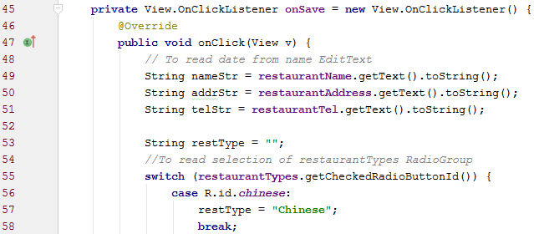
Controller
When Save Button is pressed, the Controller will handle the event by executing the code in onClick method and pass to “onSave” method

Slide 69
Controller
Line 49 to 77 - Get the data entries from UI View and save to local variables (e.g. nameStr, addrStr and etc.)

Slide 70
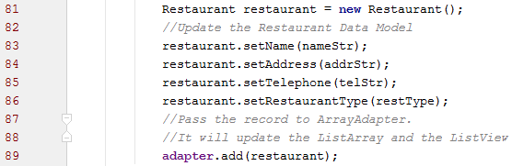
Controller
Line 81 - Create a restaurant data model object or model
Line 83 to 86 – Set individual values in the data model

Slide 71
Controller
Line 89 - Add the new restaurant data model to ArrayAdapter

Slide 72
Controller
Line 89 - The adapter will update the ArrayList as well as the ListView

Slide 73
END

